Slide 1
Lecture Seven Investment Casting: Advantages and Disadvantages
Advantages:
Parts of great complexity and intricacy can be cast
Close dimensional control and good surface finish
Wax can usually be recovered for reuse
This is a net shape process - additional machining is not normally required
Disadvantages:
Many processing steps are required
Relatively expensive process

Slide 2
Plaster Mold Casting
Similar to sand casting except mold is made of plaster of Paris (gypsum ‑ CaSO₄‑2H₂O)
In mold-making, plaster and water mixture is poured over plastic or metal pattern and allowed to set
Wood patterns not generally used due to extended contact with water
Plaster mixture readily flows around pattern, capturing its fine details and good surface finish

Slide 3
Plaster Mold Casting: Advantages and Disadvantages
Advantages:
Good accuracy and surface finish
Capability to make thin cross sections
Disadvantages:
Mold must be baked to remove moisture
Moisture can cause problems in casting
Mold strength is lost if over-baked
Plaster molds cannot stand high temperatures
Limited to lower melting point alloys

Slide 4
Ceramic Mold Casting
Similar to plaster mold casting except that mold is made of refractory ceramic material that can withstand higher temperatures than plaster
Can be used to cast steels, cast irons, and other high‑temperature alloys
Applications similar to those of plaster mold casting except for the metals cast
Advantages (good accuracy and finish) also similar

Slide 5
Permanent Mold Casting Processes
Economic disadvantage of expendable mold casting:
A new mold is required for every casting
In permanent mold casting, the mold is reused many times
Processes include:
Basic permanent mold casting
Die casting
Centrifugal casting

Slide 6
The Basic Permanent Mold Process
Uses a metal mold constructed of two sections designed for easy, precise opening and closing
Molds used for casting lower melting point alloys are commonly made of steel or cast iron
Molds used for casting steel must be made of refractory material, due to the very high pouring temperatures

Slide 7
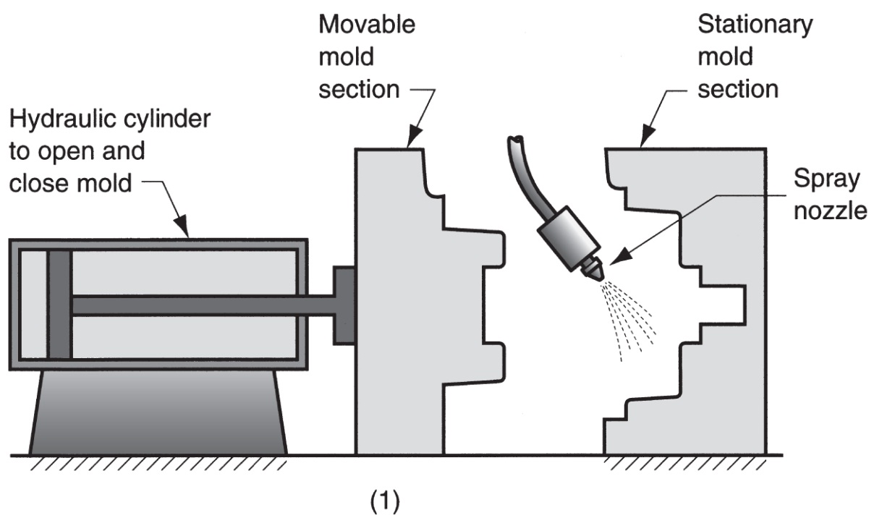
Steps in Permanent Mold Casting
(1) Mold is preheated and coated for lubrication and heat dissipation

Slide 8
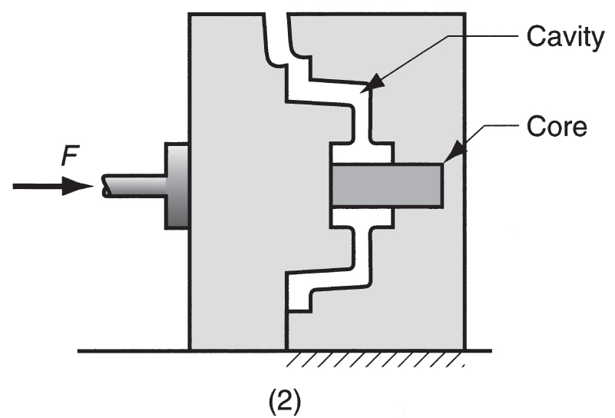
Steps in Permanent Mold Casting
(2) Cores (if any are used) are inserted and mold is closed

Slide 9
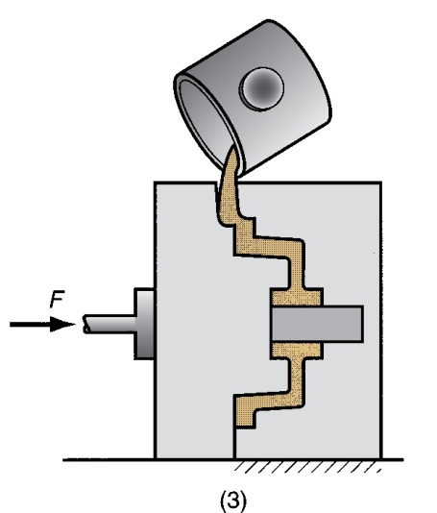
Steps in Permanent Mold Casting
(3) Molten metal is poured into the mold, where it solidifies

Slide 10
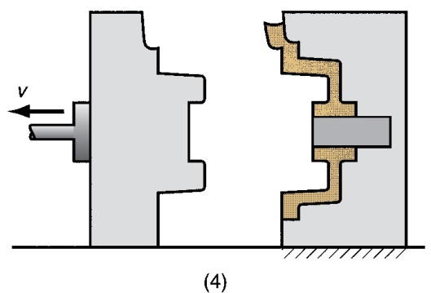
Steps in Permanent Mold Casting
(4) Mold is opened

Slide 11
Permanent Mold Casting: Advantages and Limitations
Advantages of permanent mold casting:
Good dimensional control and surface finish
Rapid solidification caused by metal mold results in a finer grain structure, so castings are stronger
Limitations:
Generally limited to metals of lower melting point
Simpler part geometries compared to sand casting because of need to open the mold
High cost of mold

Slide 12
Applications and Metals for Permanent Mold Casting
Due to high mold cost, process is best suited to high volume production and can be automated accordingly
Typical parts: automotive pistons, pump bodies, and certain castings for aircraft and missiles
Metals commonly cast: aluminum, magnesium, copper‑base alloys, and cast iron
Unsuited to steels because of very high pouring temperatures

